Slide 1
MIS 637
Data Analytics & Machine Learnin
CART Algorithm
M. Daneshmand
MD MIS 637-Fall 2020

Slide 2
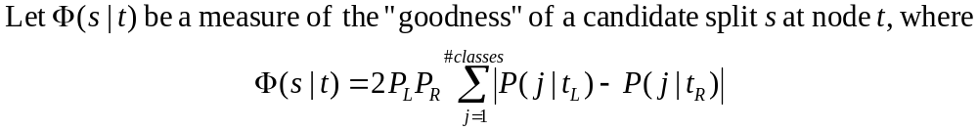
Classification and Regression Trees
  Classification and Regression Trees (CART) developed by Breiman, 1984
  Splits at decision nodes are binary, resulting in two branches, strictly binary, containing exactly two branches for each decision node
  CART recursively partitions data into subsets with similar values for target variable
  Algorithm grows tree by evaluating all predictor variables at all possible splitting values. Then chooses optimal split according to criteria bellow
  The optimal split is whichever split which maximizes “goodness” over all possible splits at node t:
MD MIS 637-Fall 2020

Slide 3
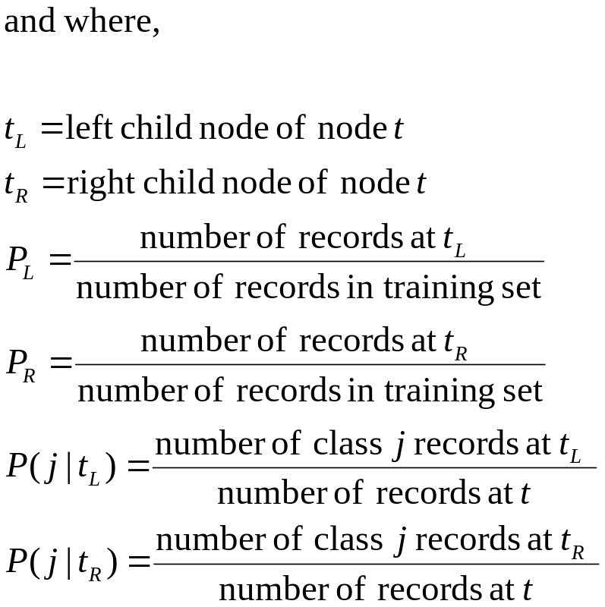
Classification and Regression Trees (cont’d)
  Optimality measure maximizes split over all possible splits, at node t
MD MIS 637-Fall 2020

Slide 4
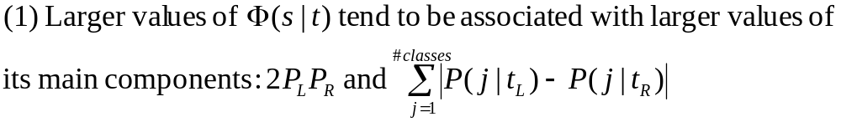
Classification and Regression Trees (cont’d)
Behavior of Optimality Measure
  Observe values of Optimality Measure components
  Recall the component values from last example
When is Optimality Measure large?
  Measure large when its main components are large
MD MIS 637-Fall 2020

Slide 5
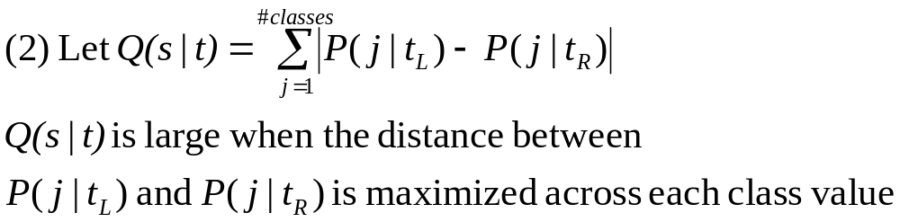
Classification and Regression Trees (cont’d)
When is component Q(s|t) large?
  Q(s|t) maximized when proportions of records in child nodes as different as possible
  Maximum occurs when, for each class value, two child nodes pure
  Credit Risk = “Good” or “Bad”; k = 2 maximum possible value for component
MD MIS 637-Fall 2020

Slide 6
Classification and Regression Trees (cont’d)
What is maximum value for 2PLPR?
  Component maximized when proportion of records in PL and PR branches equal
  Optimality measure favors balanced splits of records between left and right branches
  Theoretical maximum is 2(0.5)(0.5) = 0.5
MD MIS 637-Fall 2020

Slide 7
Classification and Regression Trees (cont’d)
Example
  Predict whether customer is classified “Good” or “Bad” credit risk using three predictor fields, according to data below
  All records enter root node, and CART evaluates possible binary splits
Customer | Savings | Assets | Income ($1000s) | Credit Risk
1 | Medium | High | 75 | Good
2 | Low | Low | 50 | Bad
3 | High | Medium | 25 | Bad
4 | Medium | Medium | 50 | Good
5 | Low | Medium | 100 | Good
6 | High | High | 25 | Good
7 | Low | Low | 25 | Bad
8 | Medium | Medium | 75 | Good
MD MIS 637-Fall 2020

Slide 8
Classification and Regression Trees (cont’d)
  Splits evaluated for Savings, Assets, and Income
  Income is numeric. CART identifies possible splits based on values it contains
  Nine candidate splits, for t = root node
Candidate Split | Left Child Node t_{L} | Right Child Node t_{R}
1 | Savings = Low | Savings = {Medium or High}
2 | Savings = Medium | Savings = {Low or High}
3 | Savings = High | Savings = {Low or Medium}
4 | Assets = Low | Assets = {Medium or High}
5 | Assets = Medium | Assets = {Low or High}
6 | Assets = High | Assets = {Low or Medium}
7 | Income <= $25K | Income > $25K
8 | Income <= $50K | Income > $50K
9 | Income <= $75K | Income > $75K
MD MIS 637-Fall 2020

Slide 9
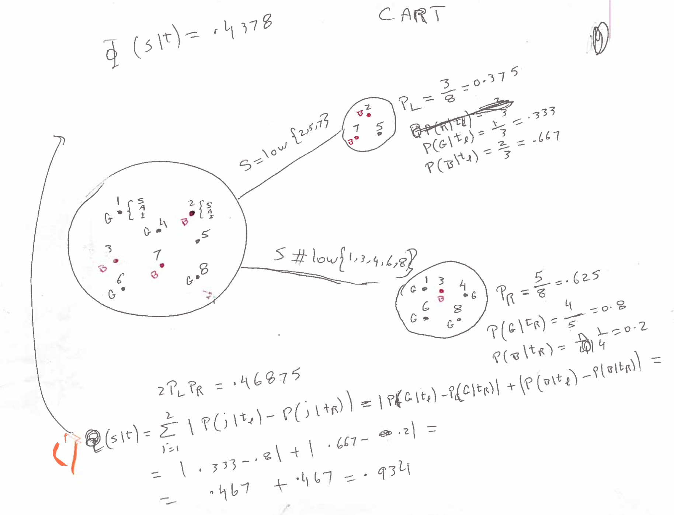
MD MIS 637-Fall 2020

Slide 10


Classification and Regression Trees (cont’d)
  Values for components of optimality measure candidate splits, t = root node
Split | P_{L} | P_{R} | P(j| t_{L}) | P(j| t_{R}) | 2P_{L} P_{R}
1 | .375 | .625 | G: .333 B: .667 | G: .8 B: .2 | 0.46875 | 0.934 | 0.4378
2 | 0.375 | 0.625 | G: 1 B: 0 | G: 0.4 B: 0.6 | 0.46875 | 1.2 | 0.5625
3 | 0.25 | 0.75 | G: 0.5 B: 0.5 | G: 0.667 B: 0.333 | 0.375 | 0.334 | 0.1253
4 | 0.25 | 0.75 | G: 0 B: 1 | G: 0.833 B: 0.167 | 0.375 | 1.667 | 0.6248
5 | 0.5 | 0.5 | G: 0.75 B: 0.25 | G: 0.5 B: 0.5 | 0.5 | 0.5 | 0.25
6 | 0.25 | 0.75 | G: 1 B: 0 | G: 0.5 B: 0.5 | 0.375 | 1 | 0.375
7 | 0.375 | 0.625 | G: 0.333 B: 0.667 | G: 0.8 B: 0.2 | 0.46875 | 0.934 | 0.4378
8 | 0.625 | 0.375 | G: 0.4 B: 0.6 | G: 1 B: 0 | 0.46875 | 1.2 | 0.5625
9 | 0.875 | 0.125 | G: 0.571 B: 0.429 | G: 1 B: 0 | 0.21875 | 0.858 | 0.1877
MD MIS 637-Fall 2020

Slide 11
Classification and Regression Trees (cont’d)
  Optimality measure maximized to 0.6248, when Assets = “Low” (Left branch), Assets = “Medium or High” (Right branch)
  Left branch terminates to pure leaf node; both records have target value = “Bad Risk”
  Right branch diverse and calls for further partitioning
Root Node (All Records)
Assets = Low, Medium, High?
Assets = Low
Assets = Medium or High
Bad Risk
(Records 2, 7)
Decision Node A
(Records 1, 3, 4, 5, 6, 8)
MD MIS 637-Fall 2020

Slide 12
Classification and Regression Trees (cont’d)
Additional Data Partitions Using CART
  CART grows full tree by iterating twice more. Creates candidate splits, and splits records at decision node according to optimality measure
Root Node (All Records)
Assets = Low, Medium, High?
Assets = Low
Assets = Medium or High
Bad Risk
(Records 2, 7)
Decision Node A
(Records 1, 3, 4, 5, 6, 8)
Savings = High
Savings = Low or Medium
Decision Node B
(Records 3, 6)
Good Risk
(Records 1, 4, 5, 8)
Assets = High
Assets = Medium
Good Risk
(Records 6)
Bad Risk
(Records 3)
MD MIS 637-Fall 2020

Slide 13
Classification and Regression Trees (cont’d)
Classification Error Rate
  CART recursively builds tree by following procedure outlined previously
  After tree “fully grown”, not all leaf nodes necessarily homogenous. Some are diverse leaf nodes
  Leads to level of classification error
  Consider records in table below. Cannot be further partitioned, and classified as “Bad”
Customer | Savings | Assets | Income | Credit Risk
004 | High | Low | <=$30K | Good
009 | High | Low | <=$30K | Good
027 | High | Low | <=$30K | Bad
031 | High | Low | <=$30K | Bad
104 | High | Low | <=$30K | Bad
MD MIS 637-Fall 2020

Slide 14
Classification and Regression Trees (cont’d)
  Probability that record in leaf node classified correctly (as “Bad”) is 3/5 = 0.60 = 60%
  Classification error rate for leaf node is 0.40 = 40%. 2/5 “Good” records classified incorrectly (“Bad”)
  CART calculates classification error rate for tree this way
  Each leaf node weighted proportionally to number of records it contains
Pruning
  Subset of records to partition becomes smaller
  Data less representative of training set population
MD MIS 637-Fall 2020

Slide 15
Classification and Regression Trees (cont’d)
  Fully grown tree has lowest classification error rate
  However, resulting model overfits training set
  CART avoids memorizing training set by pruning nodes and branches that reduce generalizability
  CART algorithm finds adjusted classification error rate that penalizes tree for having too many leaf nodes (too much complexity)
MD MIS 637-Fall 2020

